Slide 1
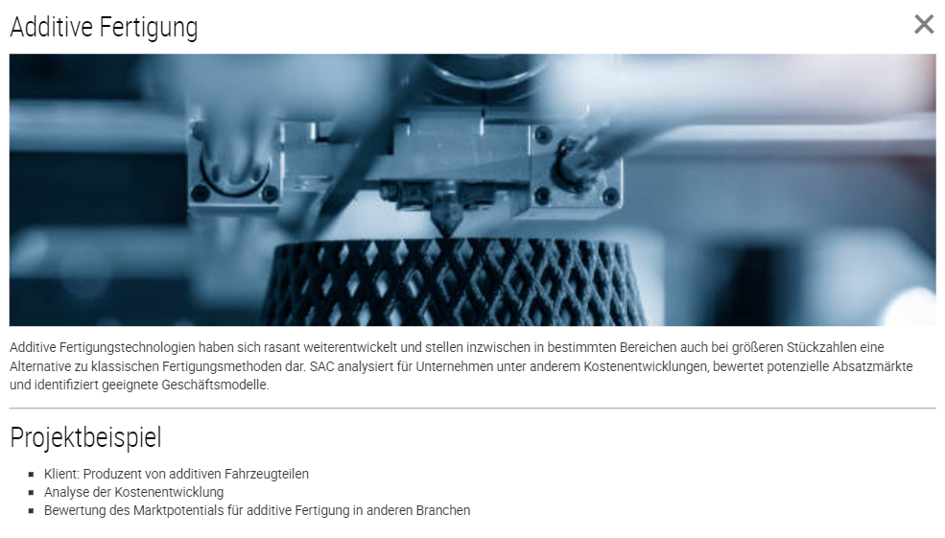
SERVICES
Additive Manufacturing
Additive manufacturing technologies have rapidly evolved and now represent an alternative to traditional manufacturing methods in certain areas, even for larger quantities. SAC analyzes cost developments for companies, evaluates potential sales markets, and identifies suitable business models.
Project example
Client: Producer of additive vehicle parts
Analysis of cost development
Assessment of market potential for additive manufacturing in other industries

Slide 2
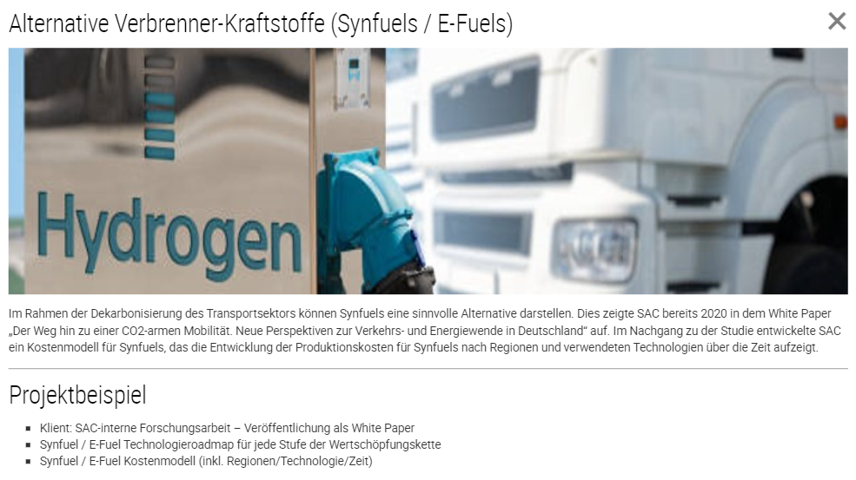
SERVICES
Alternative ICE-fuels (Synfuels / E-Fuels)
In the context of decarbonizing the transport sector, Synfuels can represent a meaningful alternative. SAC already highlighted this in 2020 in the white paper "The Path Towards Low-CO2 Mobility. New Perspectives on the Transportation and Energy Transition in Germany". Following the study, SAC developed a cost model for Synfuels that displays the evolution of production costs for Synfuels by region and the technologies used over time.
Project example
Client: SAC internal research – published as a White Paper
Synfuel / E-Fuel technology roadmap for each stage of the value chain
Synfuel / E-Fuel cost model (including regions/technology/time)

Slide 3
SERVICES
Mobility of the future & digitization
In order to ensure sustainable mobility, cities and municipalities need to develop modern mobility concepts. SAC supports the development of such mobility concepts in interaction with IT and telecommunications technologies.
Project example
Client: Tourism company
Development of a mobility concept incl. profitability analysis

Slide 4
SERVICES
Vehicle E/E architecture
Due to the increasing share of software in vehicles, the automotive industry is facing a radical change in E/E architecture. SAC supports companies in making strategic use of this change and identifying market opportunities.
Project example
Client: Telecommunications group
Identification of potential new business areas

Slide 5
SERVICES
Powertrain electrification
While most passenger car manufacturers show strong progress in the electrification of their portfolios, many commercial vehicle manufacturers are still at the beginning of the electrification of their models. SAC evaluates the regulatory framework, technical and market opportunities for OEMs and suppliers and derives clear strategic recommendations for action.
Project example
Client: Commercial vehicle manufacturer
Development of EV strategy in core markets
Comprehensive TCO calculation for market segments with biggest potential

Slide 6
SERVICES
EV battery recycling
Regulatory requirements and risks in sourcing of battery raw materials (e.g. price volatility, geopolitical conflicts) are forcing OEMs to establish closed material cycles. SAC supports OEMs in the conception and implementation of an overall raw material, battery and recycling strategy. For recycling companies, SAC evaluates business models and go-to-market strategies.
Project example
Client: European OEM
Evaluation of future secondary material streams for EV battery production
Business Case EV battery recycling
Strategy plan for EV battery recycling

Slide 7
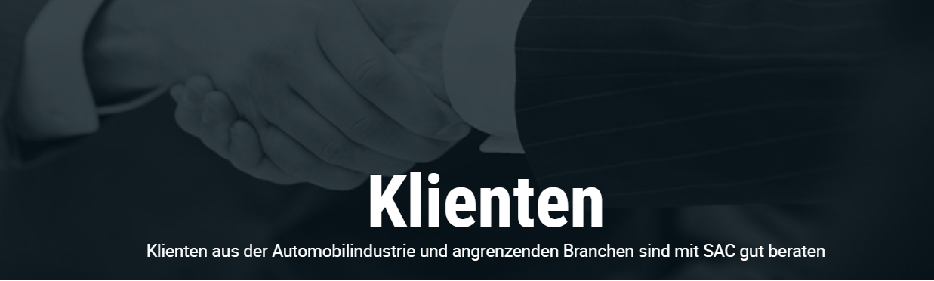
CLIENTS
Clients
Clients from the automotive industry and related sectors are well-advised with SAC

